Slide 1
IBM AI -INTERNSHIP

Slide 2
STUDENT DETAILS
Name : B.SRI SAI DINESH
SkillSBuild Email Id : Dinesh19262@gmail.com
College Name : Aditya College Of Engineering
College State : Andhra Pradesh
Internship Domain : Artifical Intelligence
Start Date and End Date : 5TH JUNE -23 JULY

Slide 3
PROJECT TOPIC
Employee _Burnout_Analysis and Predictions

Slide 4
AGENDA
This project focuses on analyzing and predicting employee burnout in the workplace. The agenda includes an introduction to the project and its objectives, followed by a literature review to understand the existing research on burnout and its contributing factors. The data collection and preparation phase involve identifying relevant sources and cleaning the data. Statistical analysis and machine learning models will be utilized to explore patterns, correlations, and predict burnout levels. The project will provide predictive insights and recommendations for addressing burnout. Additionally, ethical considerations and limitations will be discussed, and the project will conclude with suggestions for future research.

Slide 5
PROJECT OVERVIEW
Employee burnout is a pressing concern in today's workforce, impacting both individuals and organizations. This project aims to address this issue through an analysis and prediction approach. By conducting a comprehensive literature review, we will explore existing research on burnout and identify the key factors contributing to its development. The project will then proceed to collect and preprocess relevant data from various sources, ensuring its accuracy and reliability. Utilizing statistical analysis techniques, we will uncover patterns and correlations related to burnout, providing valuable insights into its manifestation and potential preventive measures. Furthermore, machine learning models will be employed to develop predictive capabilities, enabling proactive identification of individuals at risk of burnout. The project's outcomes will encompass actionable recommendations for organizations to foster healthier work environments and prioritize employee well-being.
This research project acknowledges the importance of ethical considerations and will maintain strict privacy and confidentiality standards throughout the data collection and analysis processes. Limitations, such as data availability and potential biases, will also be discussed and transparently communicated. By disseminating the findings, conclusions, and recommendations, this project aims to contribute to the broader understanding of employee burnout and pave the way for future research and intervention strategies to alleviate this critical issue in the workplace.

Slide 6
WHO ARE THE END USERS
The end users of the project can vary depending on the specific context and objectives. However, some potential end users of the project on employee burnout analysis and predictions could include:
1. Human Resources (HR) Professionals: HR professionals can utilize the project's findings and recommendations to develop strategies and interventions aimed at reducing employee burnout within their organizations. They can implement measures to improve employee well-being and create a healthier work environment.
2. Managers and Supervisors: Managers and supervisors play a crucial role in supporting and managing their teams. The project's insights can help them identify signs of burnout in their employees and take proactive measures to prevent or address burnout on an individual or team level. They can use the predictions to allocate resources and support employees who are at a higher risk of burnout.
3. Organizational Leaders and Executives: Executives and leaders within organizations can benefit from the project's outcomes to gain a deeper understanding of the impact of burnout on their workforce and overall organizational performance. They can make informed decisions about policies, programs, and resource allocation to create a culture that prioritizes employee well-being and mitigates burnout.
4. Researchers and Academics: The research community and academics studying employee burnout can utilize the project's findings as a reference and contribute to the existing body of knowledge. It can serve as a foundation for further research and exploration of the topic.
It is important to note that the project's insights and recommendations should be tailored to the specific needs and context of the end users, considering factors such as the industry, organizational size, and cultural nuances.

Slide 7
SOLUTION AND PRESENTATION
The solution would encompass a comprehensive analysis of employee burnout, utilizing statistical analysis and machine learning techniques. It would involve data collection, preprocessing, and the application of appropriate models to predict burnout levels. The solution would generate actionable insights, including identification of key factors contributing to burnout and recommendations for mitigating burnout in the workplace.
The presentation of the project's findings and recommendations would aim to effectively communicate the insights to the intended audience. It would involve the use of visual aids such as charts, graphs, and infographics to present the analysis results in an easily understandable manner. The presentation would include an overview of the project objectives, methodology, and data sources. It would then delve into the key findings, highlighting patterns, correlations, and predictive capabilities related to burnout. The presentation would conclude with a clear and concise summary of the recommendations for addressing burnout and improving employee well-being. The presentation should be engaging, informative, and tailored to the specific needs and preferences of the audience, such as HR professionals, managers, executives, and researchers. It is important to provide ample opportunity for questions and discussions to ensure a thorough understanding and facilitate further collaboration or implementation of the recommendations.

Slide 8
SOLUTION AND ITS VALUE PROPOSITION
The solution in the project on employee burnout analysis and predictions involves a systematic approach to understanding, predicting, and mitigating burnout in the workplace. By employing statistical analysis and machine learning techniques, the project offers valuable insights into the factors contributing to burnout and provides predictive models to identify individuals at risk. The solution encompasses the following components:
1. Comprehensive Analysis: The project conducts a thorough analysis of employee burnout, considering various factors such as workload, job satisfaction, work-life balance, and performance metrics. This holistic approach ensures a comprehensive understanding of the causes and manifestations of burnout.
2. Predictive Modeling: Through the utilization of machine learning models, the project develops predictive capabilities to identify employees at a higher risk of burnout. This enables proactive intervention and support, allowing organizations to address burnout before it becomes a severe issue.
3. Actionable Recommendations: Based on the insights gained from the analysis and predictive models, the project provides practical recommendations for mitigating burnout. These recommendations may include strategies for workload management, promoting work-life balance, fostering a supportive work environment, or implementing wellness programs.
The value proposition of this solution lies in its ability to empower organizations with actionable insights and strategies to tackle employee burnout effectively. By proactively identifying individuals at risk and implementing targeted interventions, organizations can improve employee well-being, enhance job satisfaction, reduce absenteeism, and boost overall productivity. This solution contributes to creating healthier work environments, nurturing a positive organizational culture, and ultimately improving employee retention and satisfaction. Furthermore, the project's findings and recommendations can serve as a valuable resource for researchers, HR professionals, managers, and executives, supporting evidence-based decision-making and promoting a more sustainable and fulfilling work-life experience for employees.

Slide 9
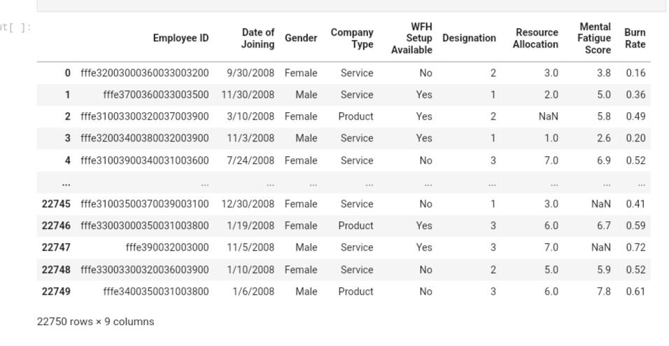
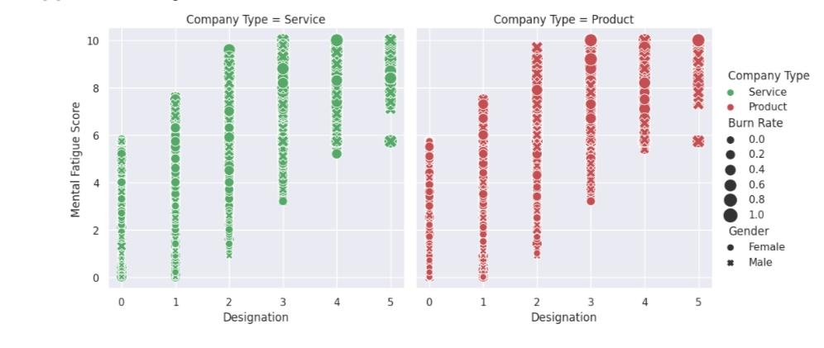
MODELLING

Slide 10
RESULTS
The result of the project on employee burnout analysis and predictions would encompass the following outcomes:
1. Identification of Key Factors: The project will identify the key factors contributing to employee burnout based on the analysis of the collected data. This could include factors such as workload, job demands, work-life balance, organizational culture, and interpersonal relationships.
2. Predictive Models: The project will develop predictive models using machine learning algorithms to forecast burnout levels for individual employees. These models will leverage the identified factors as predictors and provide a quantitative measure of an employee's likelihood of experiencing burnout.
3. Insights and Recommendations: The project will generate valuable insights into the patterns, correlations, and predictors of burnout within the analyzed data. These insights will inform the development of actionable recommendations to mitigate burnout and promote employee well-being in the workplace. The recommendations may include strategies for workload management, employee support programs, fostering a positive work environment, and promoting work-life balance.
4. Data-driven Decision Making: The project's results will enable organizations to make data-driven decisions regarding burnout prevention and intervention strategies. By utilizing the predictive models and recommendations, organizations can proactively identify employees at risk and implement targeted measures to reduce burnout, ultimately improving employee satisfaction and productivity.
5. Future Research Directions: The project's findings may highlight areas for further research and exploration. It may identify gaps in understanding or uncover novel factors that contribute to burnout, paving the way for future studies and investigations into employee well-being and mental health.
Overall, the result of the project will provide a comprehensive understanding of employee burnout, predictive models for early identification, and evidence-based recommendations for organizations to create supportive and healthy work environments. These outcomes will contribute to mitigating burnout, enhancing employee well-being, and fostering sustainable and productive workplaces.

Slide 11
PROJECT LINKS
The project on “Employee Burnout Analysis and Predictions” was implemented using Google Colab. The project's code, data, and analysis files are stored in a GitHub repository.
GIT HUB -LINK:
https://github.com/dinesh-2003/IBM-AI-INTERNSHIP

